Slide 1


Image Classification on Intel Dataset using CNN and Transfer Learning
Ashlesha Purandare 230943025008
Mangesh Jadhav 230943025027
Swarada Pathak 230943025036
Sahil Kale 230943025042
Guided By:
Ms. Trupti Joshi
Mr. Prasad Deshmukh

Slide 2
01
02
03
PROBLEM STATEMENT
ABSTRACT
DATASET
SYSTEM ARCHITECTURE
CNN ARCHITECTURE
TRANSFER LEARNING
INCEPTIONV3
MOBILENETV2
VGG16
RESULTS
OUTPUTS
CONCLUSION
FUTURE SCOPE
04
05
06
TABLE OF CONTENTS
07
08
09
10

Slide 3

Problem Statement
The task is to develop an image classification system utilizing Convolutional Neural Networks (CNN) and Transfer Learning techniques to classify images from the Intel Image Dataset.

Slide 4
Abstract :
Image classification is a fundamental task in computer vision with wide variety of applications.
The goal of this project is to classify images from the Intel Dataset using Convolutional Neural Networks (CNNs) and transfer learning.
The dataset contains a diverse set of natural scene images across six categories: buildings, forests, glaciers, mountains, sea, and streets.
The methodology involves data preprocessing, CNN model design and training, evaluation and implementing Transfer Learning models and compute accuracy metrics on Intel dataset.
With the help of deep learning, our model aims to accurately detect and classify various types of scenic images.

Slide 5
Dataset:
The Intel Image Dataset contains around 25,000 images of size 150X150 distributed under 6 categories namely:
Buildings
Forest
Glacier
Mountain
Sea
Street

Slide 6
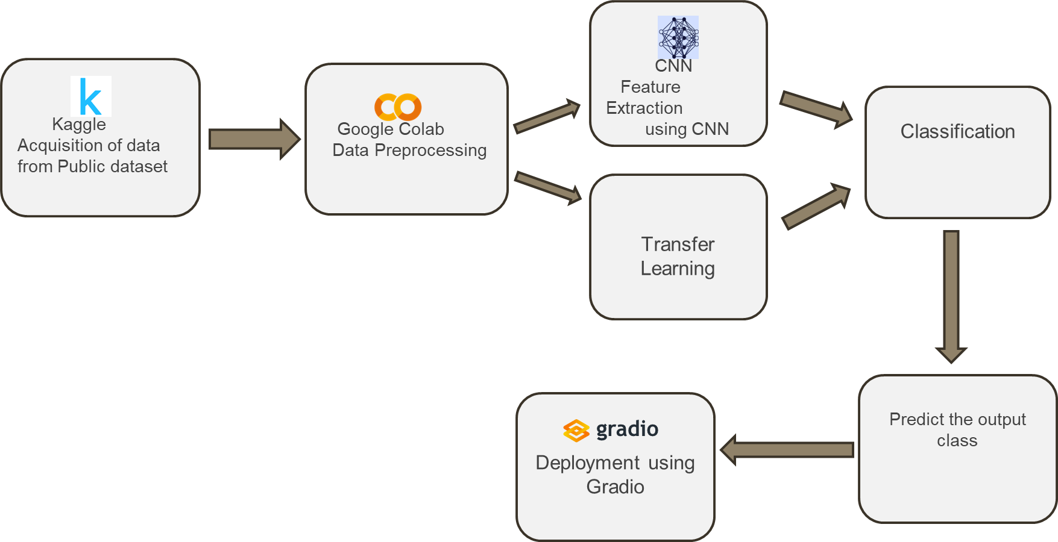
System Architecture:

Slide 7
Architecture Details:
Extracting data from Public Source such as Kaggle for the train, test and prediction dataset.
Data preprocessing and implementation on Google Colab.
Feature Extraction Using CNN(Convolution Neural Network).
Classification of dataset into desired categories.
Prediction of the output.

Slide 8
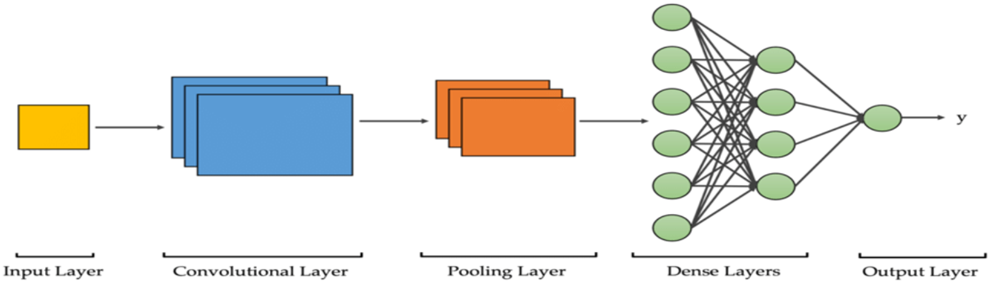



CNN Architecture:

Slide 9
Inception V3:
Transfer Learning
InceptionV3 is a convolutional neural network architecture developed by Google.
InceptionV3 is trained on the ImageNet dataset, which contains over a million images classified into 1000 categories.
Inception-v3 is a convolutional neural network that is 48 layers deep.
It consists of combination of convolution and pooling layers.
It is mostly preferred to be used for complex task and Strong feature Extraction from image.

Slide 10
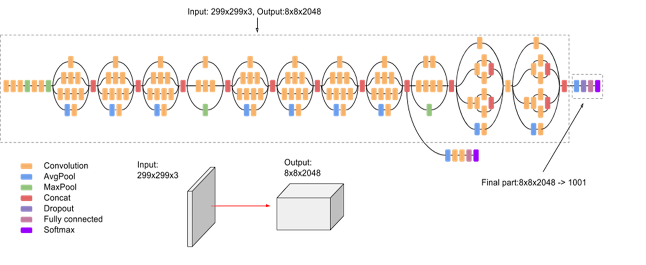
Diagram of Inception V3:

Slide 11
MobileNet V2:
Transfer Learning
MobileNetV2 was developed by a team of researchers at Google AI.
It has a lightweight architecture.
MobileNetV2 is a convolutional neural network architecture that seeks to perform well on mobile devices.
MobileNet-v2 is a convolutional neural network that is 53 layers deep.
MobileNetV2 consists of combination of convolution and pooling layers.
Preferred to use on small dataset and when we have less computing resources.

Slide 12
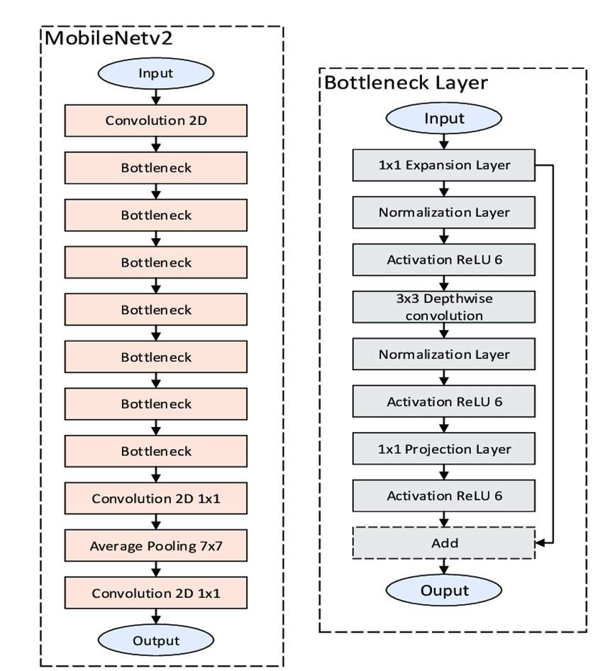
Diagram of MobileNetV2:

Slide 13
VGG 16:
Transfer Learning
Developed by the Visual Geometry Group (VGG) at Oxford University.
Despite its depth, VGG16 has a very uniform architecture, making it easy to understand and implement.
It is trained over ImageNet dataset.
Situations where alternatives to VGG16 might be preferable:
Limited data
Limited resources
Complex Tasks

Slide 14
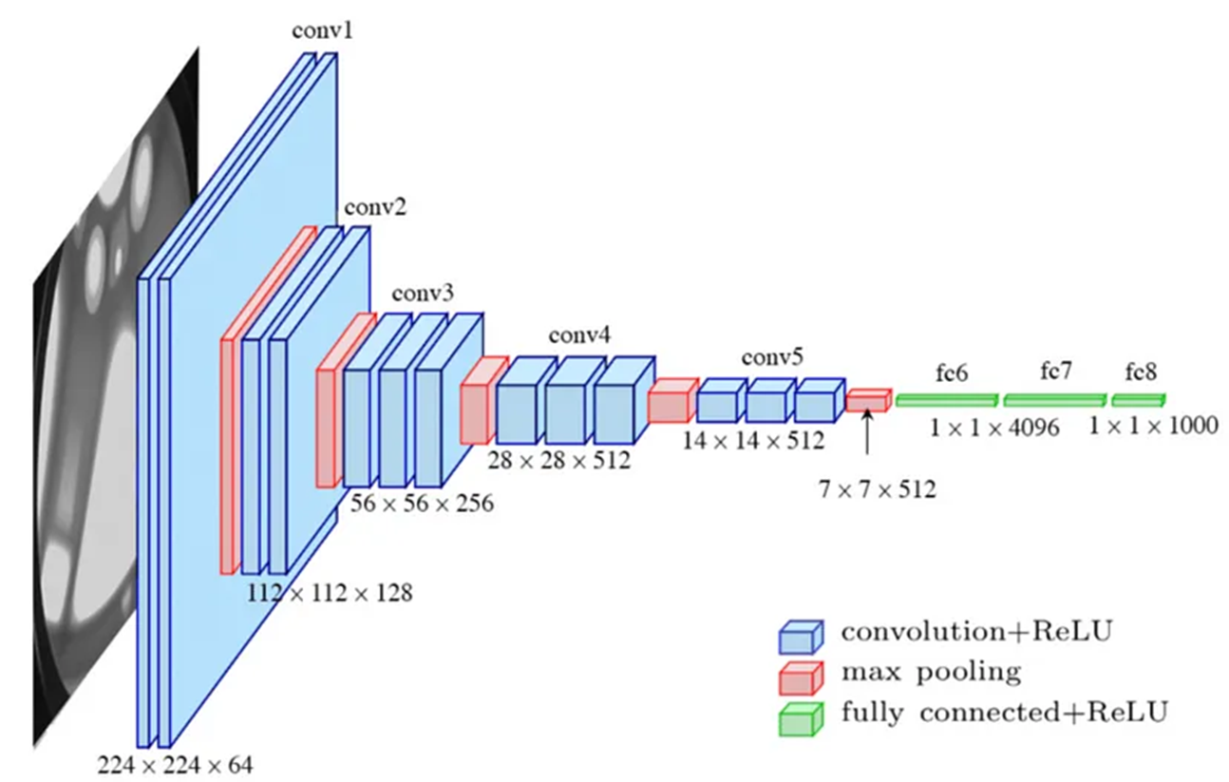
Diagram of VGG16:

Slide 15
CNN:
Trial and Error:
MODEL 2
MODEL 4
Added some more layers
10 Epoch
Training Accuracy 92.01%
Testing Accuracy=48.17%
Added some more layers
Activation function leaky relu
Adding Batch Normalization
10 Epoch
Training Accuracy =95.21%
Testing Accuracy=83.77%
MODEL 5
MODEL 3
MODEL 1
Added some more layers
Activation function relu
Adding Batch Normalization
10 Epoch
Training Accuracy =87.54%
Testing Accuracy=81.93%
Added some more layers
Activation function tanh
10 Epoch
Training Accuracy =16.99%
Testing Accuracy=18.43%
1 Layer Each
10 Epoch
Training Accuracy 89.57%
Testing Accuracy=46.20%

Slide 16
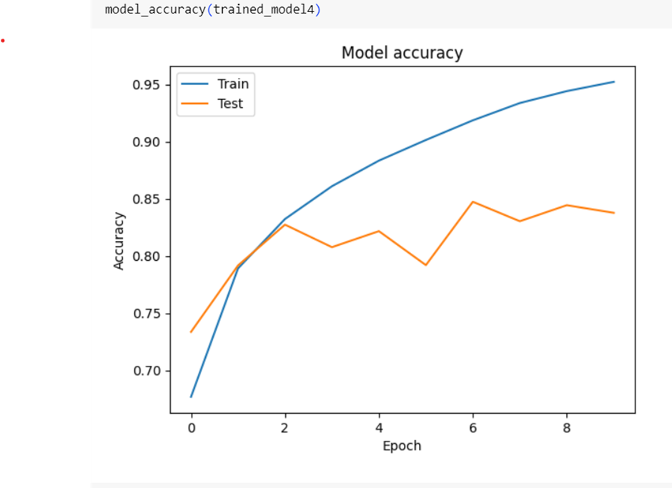
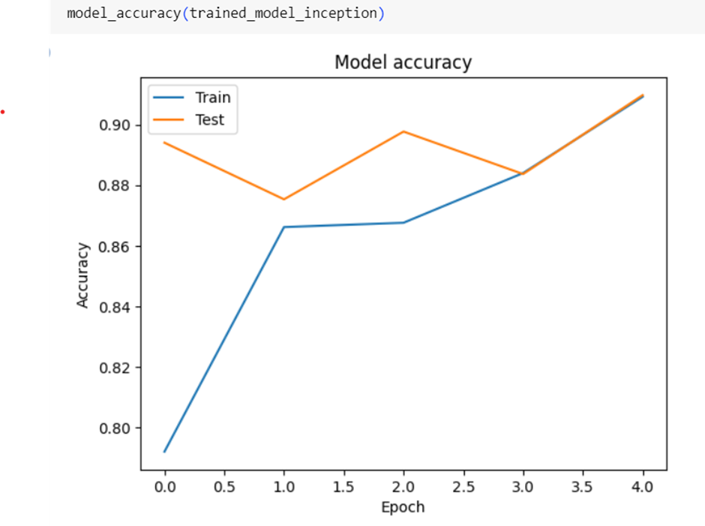
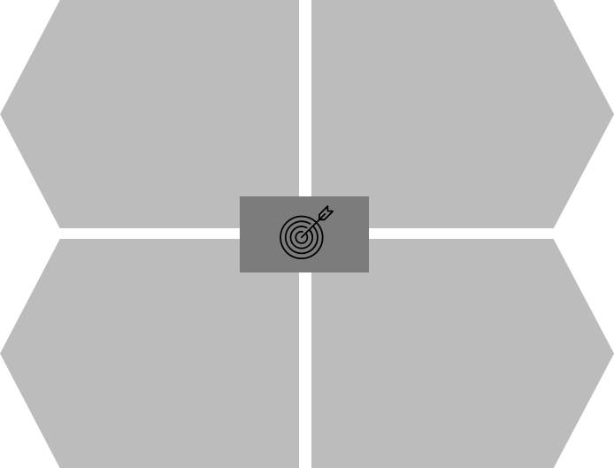
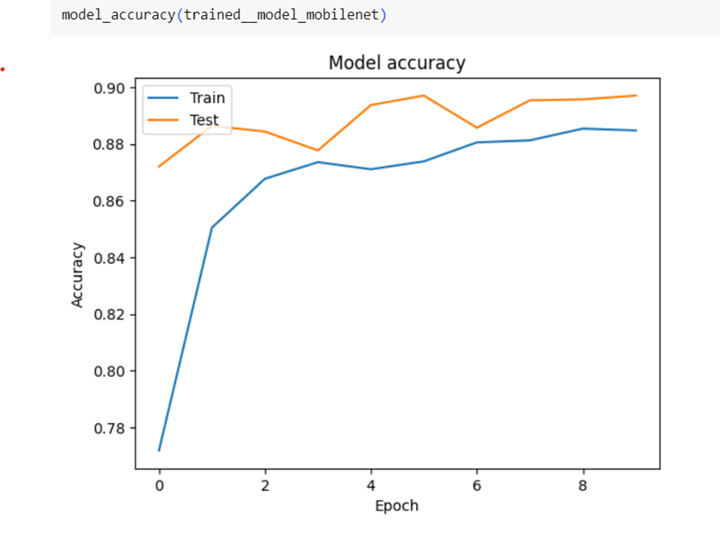
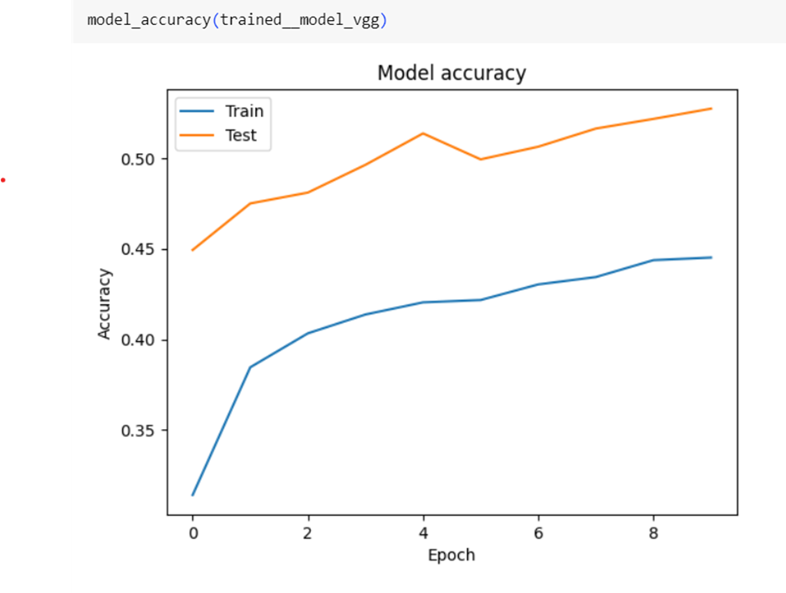
Accuracy Plots:
Basic CNN Model 4
Inception V3
MobileNetV2
VGG16

Slide 17
Results:
Model | Training Accuracy | Testing Accuracy
CNN(Model 4) | 0.9521 | 0.8377
InceptionV3 | 0.9091 | 0.9097
MobileNetV2 | 0.8847 | 0.8970
VGG16 | 0.4451 | 0.5273

Slide 18
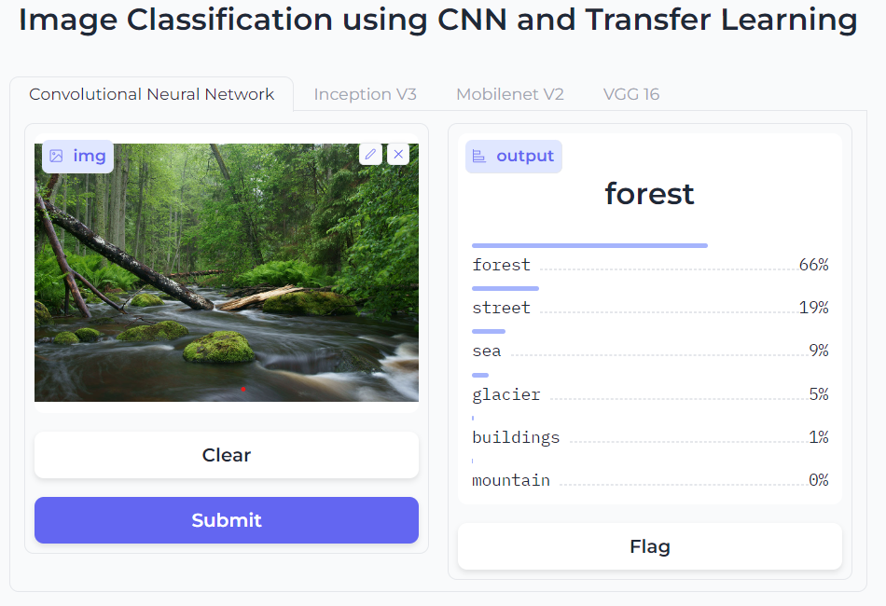
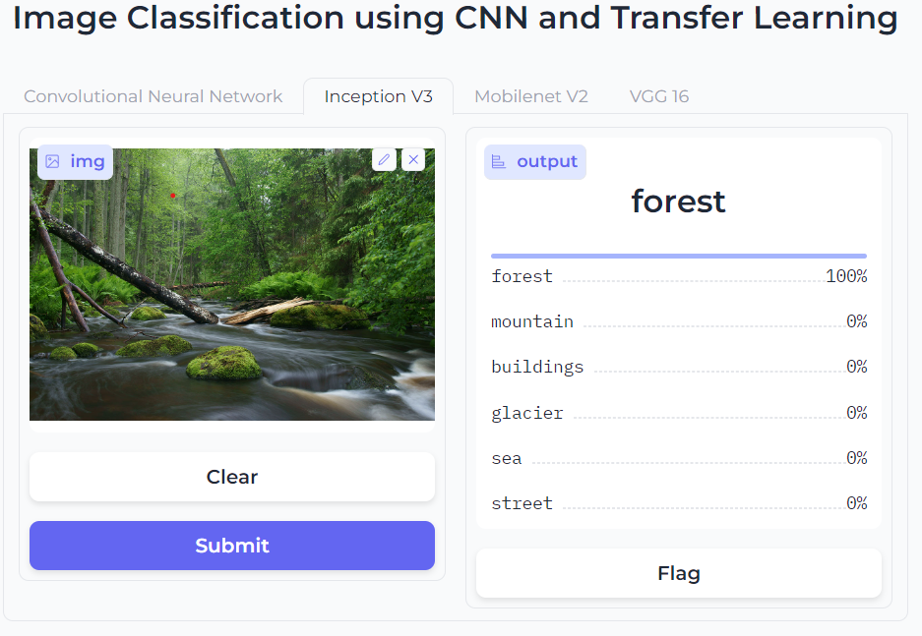
Outputs:
Inception V3
CNN

Slide 19

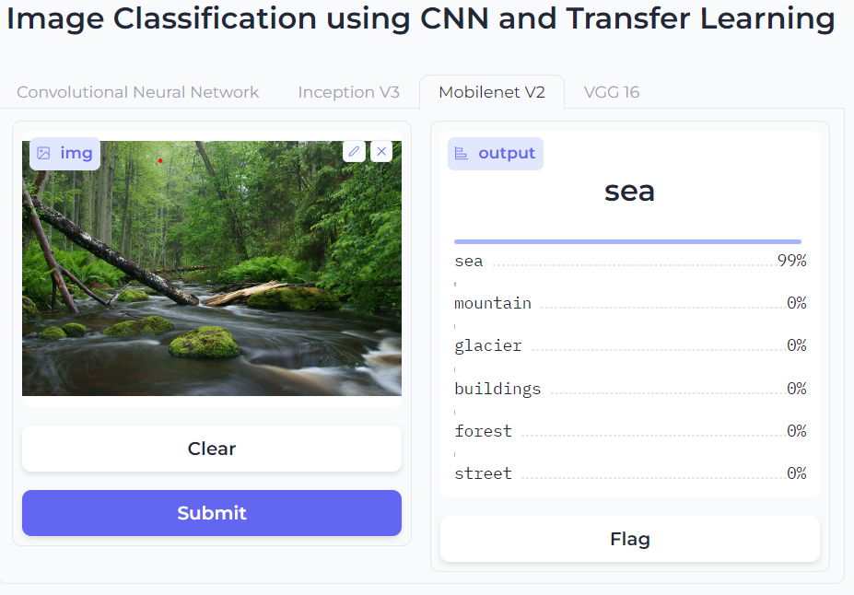
Outputs:
MobileNet V2
VGG 16

Slide 20
Conclusion:
Thus, we have successfully implemented CNN and Transfer learning model on Intel Image Dataset.
The User Interface created using Gradio shows the Predicted class of the uploaded image.
The comparative analysis of all the models is done, of which the outcomes suggest that with an accuracy of 90.37%, InceptionV3 from transfer learning model predicts the most accurate classification of Intel Image Classification Dataset.

Slide 21
Future Scope:
The applications and future scope of this model can be environmental monitoring
By adding more further enhancements the model can also be used to identify more landscape components.
Can also be used for urban planning, environmental conservation efforts

Slide 22
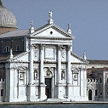

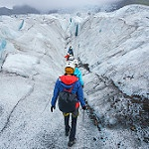
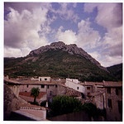
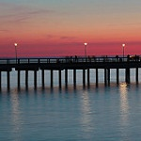
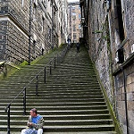
THANK
YOU !!

